Slide 1
A Changing Climate and the Financial Risk for Fossil Fuels 气候变化与化石燃料的金融风险
Anthony Hobley
Chief Executive, Carbon Tracker Initiative
Carbon Tracker Initiative首席执行官
July 17, 2017
2017年7月17日
@carbonbubble

Slide 2
Who is Carbon Tracker? Carbon Tracker(碳追踪)是谁？
An independent non-profit financial think tank funded by EU and US foundations.
欧盟和美国的基金会出资成立运营的一个独立非营利性金融智库
Identity
身份
Mission
使命
To enable a 2°C-aligned global energy system.
促成建立符合 2°C 目标的全球能源体系
Vision
愿景
Demonstrate the financial case for the transition of the fossil fuel sector in line with 2°C.
论证与2°C目标相符的化石燃料行业转型的金融理据
Notes:
Carbon Tracker is an independent not-for-profit financial think tank. We are funded by philanthropic foundations based within Europe and North America.
碳追踪（Carbon Tracker）是一个独立非营利性金融智库，由欧洲和北美的慈善基金会出资。
Our team is largely made up of former financial markets professionals from the City of London and Wall Street. Our expertise includes former heads of research at HSBC and CitiGroup, investment bank analysts, and top-tier lawyers.
我们的团队主要由来自伦敦和华尔街的原金融市场专业人士组成。各领域专家包括汇丰银行和花旗银行的前研究主管、投资银行分析师和顶级律师。
Our mission is to ensure that our global energy system is compatible with a secure climate.
我们的使命是确保全球能源体系与气候安全相适应。
While achieving this mission requires a collective effort, Carbon Tracker’s particular expertise lies in making the financial case for the transition of the fossil fuel sector in line with the 2-degree target set in the Paris Agreement.
践行这一使命需要共同努力，而 Carbon Tracker的专长是提出与《巴黎协议》中制定的2°C目标相一致的化石燃料行业转型的金融理据 。
Our initial work in 2011 on the “carbon bubble”, “unburnable carbon” and “stranded assets” gained widespread traction. It has since evolved to focus on company-level exposure, investor engagement and regulatory implications.
2011年我们在“碳泡沫”、“不可燃烧的碳”和“搁浅资产”等方面做的初步工作引起了广泛关注。后来逐步演变成聚焦公司层面的接触、投资者参与和监管方面的影响。

Slide 3
Sustainability at the heart of challenges for 21st Century 可持续性是21世纪面临的挑战的核心
The environment is at the centre of our future and driving change:
环境是我们未来的重心，正在推动变革：
Ambitious policy at international (Paris Agreement) and national (“Ecological Civilization”) levels
国际层面（巴黎协议）和国家层面（“生态文明建设”）的宏大政策
Rapid technological development
快速的技术发展
Financial markets waking up to the problem?
金融市场开始意识到这个问题？
Notes:
A supporting and sustainable environment lies at the centre of our future.
We can see that clearly in two ways:
一个有利、可持续的环境是我们未来的重心。我们可以从两个方面清楚地看到这一点：
One is the steady ramping up of political ambition. At the international level, the Paris Agreement represents our collective recognition of the challenge to preserve the long-term security of our climate.
一方面，逐步增强的政治抱负。在国际层面，《巴黎协议》代表我们就维护气候的长期安全所面临的挑战达成了共识。
Individual countries are developing equally strong appetites for change, as is demonstrated by China’s determination to tackle air pollution as part of its broader strategy for an Ecological Civilisation
各国都在萌生同样强烈的变革意愿，比如表现在作为更宏伟的生态文明建设战略的一部分，中国下定决心防治空气污染。
The other are the profound changes in the ways that we produce energy:
另一方面是我们产生能量的途径在发生深刻变化：
It is now clear that economic growth does not have to be tied to growth in carbon emissions;
现在显而易见，经济增长未必伴随着碳排放增长；
The costs of solar and wind technologies continue to astound and disrupt conventional markets – we recently saw solar tariffs in India edge out 60 gigawatts of India’s coal-fired power on a cost basis;
太阳能和风能技术的成本不断震惊和颠覆传统市场--我们最近看到印度的太阳能电价由于成本低取代了印度60千兆瓦的煤电；
And fresh announcements from Volvo, Daimler & BAIC, and the French government back up the promise of electric vehicles to revolutionise road transport.
沃尔沃、戴姆勒和北汽集团以及法国政府最新发布的消息支持发展电动车，推动公路交通运输革命的前景。
These two forces of policy and technology are increasingly working in tandem to effect change.
政策和技术这两股力量越来越有效配合，推动变革实现。
The interventions of various leaders from the financial world suggests a desire for markets to face the challenge.
金融界领袖的介入表明渴望市场直面这一挑战。

Slide 4
Private sector has central role 私营部门发挥核心作用
A green transition requires deployment of capital away from “brown” towards “green” sources of energy.
绿色转型要求把资本部署从“棕色”转向“绿色”来源的能源
This requires understanding the opportunities on the green side and the risks to the brown side.
这要求理解绿色侧的机会和棕色侧的风险
Notes:
The private sector and financial markets can play a central role in this energy transition through two groups: companies and investors.
私营部门和金融市场通过两个群体在这场能源转型中发挥核心作用：公司和投资者。
For fossil fuel-based companies, the transition requires a wind-down of their business model; a constraining of capital to lower-cost, lower-carbon projects;
对于基于化石燃料的公司，转型要求逐渐退出他们的现有商业模式；驱使资本投向成本更低、碳排放更小的项目；
For investors, what is required is an alignment of capital with sustainable development of our energy system.
对于投资者，要求资本投向与能源体系的可持续发展相符。
Aligning company and investor behavior requires understanding opportunities on the “green” side.
统一公司和投资者的行为要求理解“绿色”侧的机会。
But, as many have pointed out, the environmental-related risks to the “brown” side are not always properly understood. Once they are, company and investor behavior should adjust accordingly.
不过，正如许多人指出那样，“棕色”侧的环境相关风险并未总是得到正确理解。一旦得到正确理解，公司和投资者行为应该相应地调整。
Carbon Tracker’s particular expertise is precisely on this latter point: the risks.
Carbon Tracker(碳追踪)的专长正是在后面这一点上：风险。
All of this leads us to two questions:
所有这一切归结为两个问题：
What do policy targets mean in financial terms?
政策目标从金融角度理解的意思是什么？
How could technological development surprise?
技术发展如何带来惊喜？

Slide 5
Policy targets provide a framework for understanding the financial risks 政策目标提供理解金融风险的框架

Slide 6
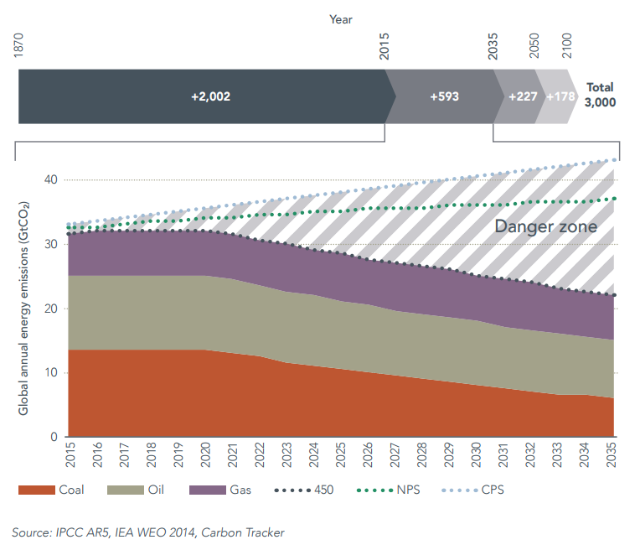
Misalignment at the macro-level 宏观层面错位
Notes:
The fundamental problem of anthropogenic climate change is well known: we cannot produce and consume significant quantities of carbon and at the same time maintain stability of our climate system.
人为活动气候变化的根本问题已经众所周知：我们不能在生产和消耗大量碳的同时保持气候系统的稳定性。
Policy targets provide a framing for us to think about the economic and financial implications.
政策目标为我们提供一个框架，从而思考经济和金融上的潜在意义。
This slide, taken from Danger Zone, shows clearly the gap between the fossil fuel needed to meet international targets (2°C) and the path that we are currently on.
本页摘自 Danger Zone(危险区)，清楚显示为了达到国际目标 (2°C)所需的化石燃料与我们目前所在路径之间的差距。
Not only does this show the challenge we face of constraining that production and consumption of carbon, but it also highlights the financial risk that could result if policy ambition is met.
这不仅显示我们在限制碳产量和消耗量上面临的挑战，还突显如果政策抱负得以实现，可能导致的金融风险。

Slide 7
Company-level impact 公司层面影响
Our carbon supply cost curves follow economic logic of efficient capital allocation
我们的碳供给成本曲线符合高效资本配置的经济学逻辑
Notes:
To understand the risk in practical terms, Carbon Tracker’s uses economic logic to help answer two key questions:
为了理解这种风险的实际意义， Carbon Tracker(碳追踪)运用经济学逻辑来帮助回答两个关键问题：
How are companies affected by events unfolding at the macro-level
公司如何受到宏观层面正在展开的事件影响
How can companies adapt their strategy to limit their exposure?
公司如何调整他们的战略，限制他们受到的影响？
Our carbon supply cost curve approach combines demand and supply to understand the impacts over the next two decades.
我们的碳供给成本曲线法结合供需来理解未来二十年的后续影响。
Using industry data for oil, gas and coal, we compare potential future supply against a 2°C demand scenario, based on the International Energy Agency’s 450 Scenario.
通过油气和煤炭的行业数据，根据国际能源署的 450情景，我们对比未来潜在供给和2°C需求情景。
We stack up potential supply on a cost curve and assume that the lowest cost supply is consumed first.
我们把潜在供给嵌套在成本曲线上，假设先消耗最低成本供给。
Comparing this potential supply against the 2°C demand intersect enables us to determine which supply is within 2°C and which is outside 2°C.
通过比较这种潜在供给与 2°C需求的交叉点，我们可以确定哪个供给在 2°C以内，哪个在 2°C以外。

Slide 8
Some companies better prepared than others 有些公司准备比其他公司充分
Notes:
Our cost curve approach allows us to analyse the project-level and then company-level impact.
我们的成本曲线法使我们可以分析项目层面，然后是公司层面的影响。
Naturally, the extent to which a company’s potential supply is surplus to the 2°C demand level varies significantly.
一个公司的潜在供给多于 2°C需求水平的程度自然会有很大差异。
As an example, the chart shows the 10 best and 10 worst performing companies based on this metric.
比如，该表显示根据这一衡量标准表现最好十家公司和最差十家公司。
One of the key metrics that we use is proportion of potential capital expenditure from 2017-2025 that is not needed. This provides investors with one useful indication of how a company might fare relative to its peers.
我们采用的关键指标之一是2017-2025年间不需要的潜在资本支出比例。这为投资者提供了一个很有用的指标，即与其同行相比一家公司可以如何经营。

Slide 9
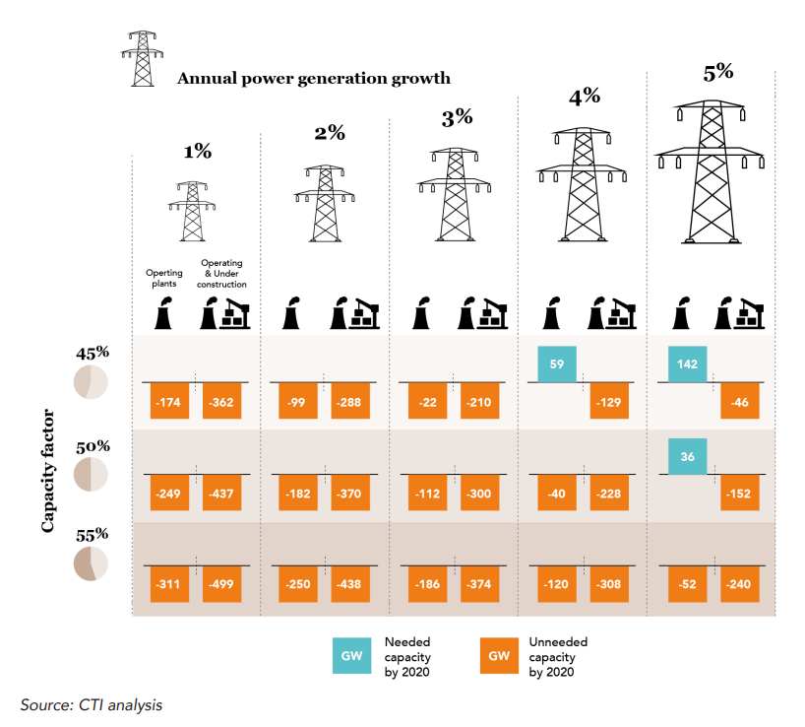
Government plans indicate changes to fuel mix 政府规划显示燃料结构的变化
Environmental targets have local implications.
环境目标具有本地影响
Policy ambition can provide important market signals.
政策抱负可以折射出重要市场信号
Notes:
China provides a prime example of a rapidly changing energy system and how action can be taken to adapt.
中国提供了能源体系快速变化以及采取何种行动来适应变化的最好例子。
The 13th Five Year Plan (FYP), which takes us through to 2020, demonstrates substantial ambition for developing low carbon forms of energy, particularly wind and solar.
将持续到2020年的“十三五规划”显示出发展低碳能源，尤其是风能和太阳能的远大抱负。
As low-carbon energy continues to occupy more of the power mix, we analysed what impact the energy targets of the 13th FYP would have on China’s existing and new coal-fired power generation.
随着低碳能源在电能中的比重继续加大，我们分析了“十三五规划”的能源目标将对中国的现有和新建火力发电产生什么影响。
As the chart shows, only strong growth in power generation and low capacity factors would justify additional capacity from existing plants. We saw no room for plants under construction to run alongside existing capacity.
如图所示，只有发电量大幅增长和低产能因素才有理由扩大现有发电厂的产能。我们认为在建电厂没有与现有产能并行开工的空间。
Of course, this is an issue that the Chinese government is acutely aware of. Reports in January of this year indicated that the government has already suspended 120 gigawatts of coal-fired capacity, 54 gigawatts of which is under construction.
当然，中国政府已经清醒地认识到了这个问题。今年一月份的报告显示政府已经暂停了120千兆瓦的煤电产能，其中54千兆瓦属于在建产能。
The key takeaway is that policy doesn’t need to be fully implemented in order for us to see and understand the possible implications.
核心思想是不需要完全实施政策，我们也可以看出并理解可能的潜在影响。
Emissions goals themselves can define the potential outcome.
排放目标本身也可以界定出潜在效果。
Indeed, China has a history of exceeding its own targets for developing low carbon power. That should be a warning that should be heeded.
事实上，中国一直有超出自己制定的发展低碳电力的目标的历史。这是一个值得警惕的信号。

Slide 10
Technological disruption may surprise incumbents and investors 技术颠覆可能会令在位者和投资者吃惊

Slide 11
Demand mismatch sets up potential misread 需求不匹配引起潜在的误读
Notes:
The expectations of fossil fuel companies for the future landscape of energy appear to run contrary to the signals sent by policymakers.
化石燃料公司对未来能源图景的预期看起来与政策制定者释放的信号相悖。
This chart compares company demand forecasts. We can see that in 2012, fossil fuels made up roughly 80% of energy demand. Looking to the International Energy Agency’s 2°C scenarios in 2040, we seen that total energy demand increases somewhat, but the proportion of fossil fuel demand falls significantly, to between 45-60% of total energy demand.
该图对比了公司需求预测。我们可以看出在2012年，化石燃料约占能源需求的80%左右。展望国际能源署的2040年2°C情景，我们看到能源总需求有所增加，但是化石燃料需求占比锐减至能源总需求的 45-60%之间。
Scanning the outlooks of some of the world’s largest fossil fuel companies we note two points:
纵览全世界一些最大的化石燃料公司的未来展望，我们注意到两点：
The overall level of demand is significantly higher than under possible 2°C scenarios;
总体需求水平远高于可能的2°C情景；
The share of fossil fuel demand remains relatively stable, with few companies anticipating a significant decline in the demand for fossil fuels.
化石燃料需求的份额依然比较稳定，极少数公司预计化石燃料需求会大幅减少。

Slide 12
Different assumptions tell a different story 不同假设得出不同结论
Solar PV could supply 23% of global power by 2040 and 29% by 2050
太阳能光伏到2040年可以提供全球电力的23%，到2050年达到29%
Electric vehicles could provide 35% of road transport by 2035 and over 66% by 2050
电动车到2035年占公路交通的35%，到2050年超过66%
Coal demand peak in 2020
煤炭需求到2020年达到最高水平
Oil demand peak in 2020
石油需求到2020年达到最高水平
Gas demand curtailed
燃气需求减少
Notes:
We wanted to analyse deeper the extent to which these companies might be wrong.
我们想更深入地分析，这些公司可能出错的地方。
Of course, we have seen coal companies in the United States use bullish forecasts for future coal demand, only to see the U.S. coal market enter structural decline at the expense of their investors.
当然了，我们看到美国的煤炭公司对未来煤炭需求做出了上涨的预测，结果却是眼看着美国煤炭市场进入结构性萎缩，其投资者为此付出代价。
Working with Imperial College London, we used an integrated assessment model (IAM) to analyse the potential for solar PV and electric vehicle technologies to disrupt conventional fossil fuel markets.
与伦敦帝国理工学院合作，我们运用了综合评价模型（IAM）来分析太阳能光伏和电动车技术颠覆常规化石燃料市场的潜力。
Their model, like many IAMs, used cost assumptions that were significantly out of date.
跟许多综合评价模型（IAM）一样，他们的模型采用的是非常过时的成本假设。
We simply updated them and, using a range of different policy assumptions (via a proxy carbon price), the model produced significant results:
于是我们更新了一下，采用一系列不同的政策假设（通过代用碳价格），这个模型就得出了有意义的结论：
Solar PV could supply 23% of global power by 2040 and 29% by 2050
太阳能光伏到2040年可以提供全球电力的23%，到2050年达到29%
Electric vehicles could provide 35% of road transport by 2035 and over 66% by 2050
电动车到2035年占公路交通的35%，到2050年超过66%
Coal demand peak in 2020
煤炭需求到2020年达峰
Oil demand peak in 2020
石油需求到2020年达峰
Gas demand curtailed
燃气需求减少

Slide 13
Addressing the challenges of the transition through disclosure and transparency 通过披露和透明应对转型带来的挑战

Slide 14
Disclosure shines light on risks 披露揭示风险
Investors focus on the future. They will shift capital where there is a financial justification. Key needs:
投资者面向未来。他们将把资本转向具有金融合理性的地方。关键需求：
Translate climate policy into impact on company assets (scenario analysis).
把气候政策转化成对公司资产的影响（情景分析）
Improve disclosure of the assumptions underpinning company forecasts to allow investors to scrutinize them.
改进支持公司预测的假设的披露，便于投资者仔细分析。
Notes:
Investors focus on the future.
投资者面向未来。
But they require the necessary signals to back their conviction with their capital. So that the private sector provides and receives these signals, two components are needed:
但是他们需要必要的信号来支持他们对资本的信心。所以私营部门提供并接收这些信号，需要两个组成部分：
Translation of climate policy into company-level impacts. Carbon Tracker’s market-based scenario analysis, through carbon cost curves, demonstrate that this is possible.
把气候政策转化成对公司层面的影响。 通过碳成本曲线，Carbon Tracker(碳追踪)基于市场的情景分析表明这是可能的。
Improved company disclosure of the assumptions that underpin their strategy. As our analysis shows of the U.S. coal market shows, there is significant potential for company expectations to miss the mark.
改进支持公司战略的假设的披露。如我们对美国煤炭市场的分析所示，公司的预期很可能是不准确的。
The recently published work of the FSB’s Task Force on Climate-related Financial Disclosure (TCFD) is an important step forward in building a market in improved disclosure.
金融稳定委员会（FSB）的气候相关金融披露工作组 (TCFD)最近公布的工作在建立一个披露更完善的市场上向前迈出了重要一步。

Slide 15
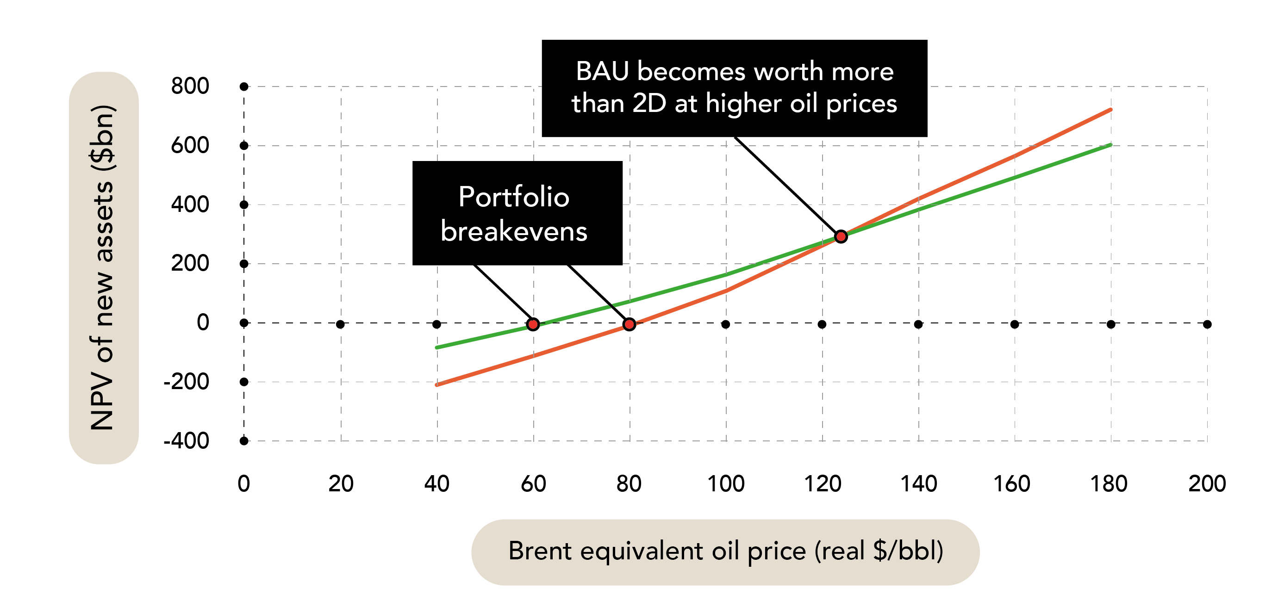
There is a financial case for oil & gas companies to wind-down 存在油气公司逐步退出的金融理据
Notes:
It is also clear that there are financial incentives in transitioning away from fossil fuels, not only at the macro-economic level, but at the company-level, too.
显然在远离化石燃料的转型上也有金融激励，不仅是在宏观经济层面，还包括在公司层面。
Our analysis of potential production from the oil and gas majors indicates that simply constraining capital to only the lowest cost, and often therefore the lowest carbon, projects, a company can be worth more to its investors in the future.
我们对油气巨头的潜在产量分析显示，仅仅是驱使资本投向成本最低，往往也因此是碳排放最低的项目，一家公司就能在未来为其投资者带来更高的市值。
The key message is: regardless of how the oil price might move up and down, energy markets are changing materially, which requires prudent spending of investors’ capital.
关键讯息：不管油价如何波动，能源市场都在发生重大变化，这要求我们谨慎使用投资者的资本。

Slide 16
Concluding thoughts 结论
Private sector and markets will play a key role in developing a sustainable energy system.
私营部门和市场将在发展可持续能源体系中发挥关键作用
Investors are forward looking, but require true pricing of market risks to deploy capital.
投资者具备前瞻性的视野，但是要求获得市场风险的真正定价以部署资本 。
Improved disclosure can make a market in climate risk
改进披露可以建立一个气候风险市场
Notes:
We would like to offer three simple concluding thoughts:
我们得出三点简单的结论：
First, the private sector and financial markets are key to developing a sustainable energy system.
第一，私营部门和金融市场是发展可持续能源体系的关键。
Second, investors are forward looking, but they require true pricing of market risks to deploy capital. Here, we think of the basket of risks including technological and digital disruption as well as unforeseen policy and regulatory action.
第二，投资者具备前瞻性的视野，但是他们要求获得市场风险的真正定价以部署资本 。在这里，我们考虑包括技术和数字颠覆在内的一篮子风险，以及不可预见的政策和监管措施。
And finally, as Governor Mark Carney has outlined, improved disclosure can help to make a market in climate-related financial disclosure.
最后，英国央行行长马克-卡尼表示，更完善的披露有助于建立一个气候相关金融披露市场。

Slide 17
Thank You. 谢谢！
Anthony Hobley
Chief Executive, Carbon Tracker Initiative
Carbon Tracker Initiative首席执行官
ahobley@carbontracker.org
www.carbontracker.org
@carbonbubble
Notes:
Thank you for listening.

